Slide 1
WIRELESS CHARGING
7376211SE129 & NIKITHA M
7376211BM125 & SHREYAA V

Slide 2
Abstract
Wireless charging has until now been limited to smartphones. Smaller, low-powered devices – earbuds, watches, fitness trackers, hearing aids, stylus pens, remotes, medical monitors, IoT sensors and many more – still need to be regularly plugged in to be charged. Many users will carry several of these at the same time and they are proliferating so rapidly that cable charging is becoming inconvenient and unsustainable.

Slide 3
Abstract
Solution: Metaboards, which does away with this multiplicity of charge leads, sockets and plugs. A platform able to charge several devices wirelessly, all at the same time. The Metaboards system will seek out rechargeable devices that are simply placed on its surface, connect and charge them all, with no need for alignment. Result: a seamless charging experience from a single power source.

Slide 4
Abstract
Standard Stuff. Metaboards operates on the NFC standard, as used by billions of handheld devices for access or payments. The NFC Forum has now approved it for low-power charging (100mW to 1W) allowing an NFC-enabled device to handle both communications and charging simultaneously. Metaboards is the first wireless charging company to demonstrate this facility.The alternative Qi standard is for smartphones, which require higher power (15W+). Qi allows only one device per charger and needs precise alignment to function.

Slide 5
Abstract
Technology and IP. The platform, protected by a host of patents (12 granted, 33 pending) and proprietary tools exploits the phenomenon of metamaterials: composite structures comprising multiple elements which support magneto-inductive waves. The charger runs an algorithm to identify the location and number of devices. Once the devices are found the charger determines the best way to deliver power fairly and efficiently to each device.
It’s deep tech, now at the demonstrator stage, able to prove the effectiveness of this ground-breaking technology.

Slide 6
Problem Statement Addressed
Bloom the world with new technologies and with new inventions. with this aspect we have come with the idea of charging the devices with wireless cables.
If this technology was implemented the communication , changing and all other problems will sorted out.
In 2019, there are about 7.3million chargers worldwide, of which about 6.5 million were private , light-duty vehicle slow chargers in home, multi-dwelling buildings and workplace.
Even though most newer phones have wireless charging, one research report showed that only 20% of people use it.
Hence, if it would become much cheaper and available in all range of markets this would make a drastic change in emerging technologies.

Slide 7
Existing Solution to the Problem Addressed
Technology is supposed to keep things simple. We use different gadgets for different purposes to make our life similar. Yet,different devices with different charging cables and different pots make things really complicated when it’s time to charge them. That’s why we use cabless- a multiple devices-in-1 wireless changing cables that allows to charge pretty much every device we have with only one o without a cable.

Slide 8
Proposed Solution to the Problem Addressed
Standard Stuff. Metaboards operates on the NFC standard, as used by billions of handheld devices for access or payments. The NFC Forumhas now approved it for low-power charging (100mW to 1W) allowing an NFC-enabled device to handle both communications and charging simultaneously. Metaboards is the first wireless charging company to demonstrate this facility.The alternative Qi standard is for smartphones, which require higher power (15W+). Qi allows only one device per charger and needs precise alignment to function.

Slide 9
Proposed Solution to the Problem Addressed
Technology and IP. The platform, protected by a host of patents (12 granted, 33 pending) and proprietary tools exploits the phenomenon of metamaterials: composite structures comprising multiple elements which support magneto-inductive waves. The charger runs an algorithm to identify the location and number of devices. Once the devices are found the charger determines the best way to deliver power fairly and efficiently to each device.

Slide 10
Project Work Plan
Wireless charging uses electromagnetic fields to transfer power from a transmitter to a receiver application to charge the battery. This erases the need for physical connectors and cables to transfer power – one of many benefits of this technology. Wireless charging is a complex subject that requires in-depth system knowledge and expertise. Designers have to understand antennas and how they interact with surrounding structures. To successfully transfer power wirelessly, the power delivery has to be precisely controlled

Slide 11
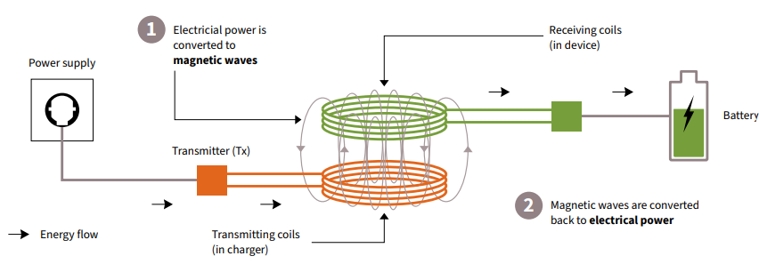

Slide 12
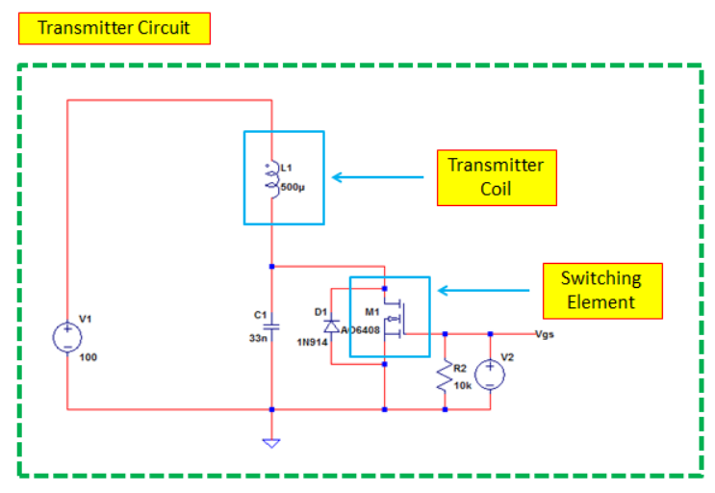
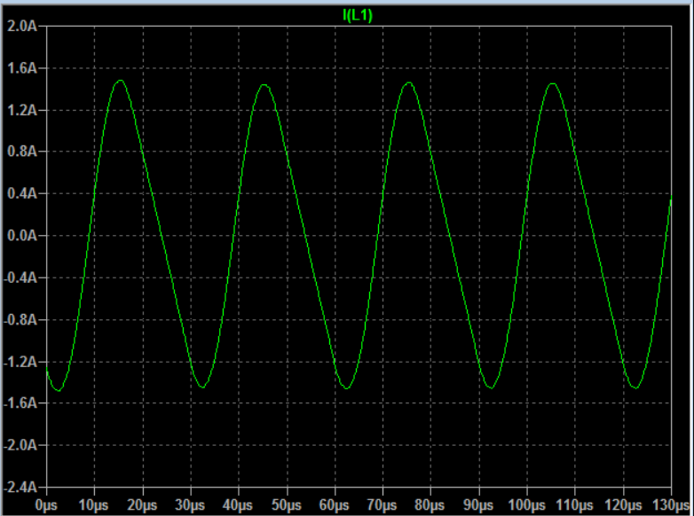
Block Diagram and/or Circuit Diagram

Slide 13
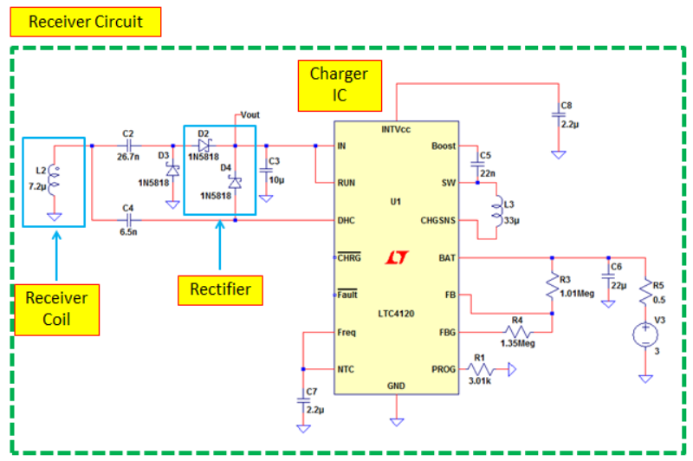
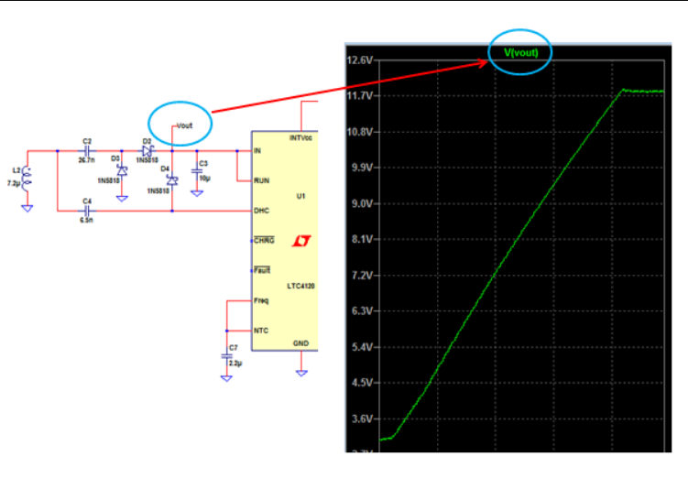
Block Diagram and/or Circuit Diagram

Slide 14
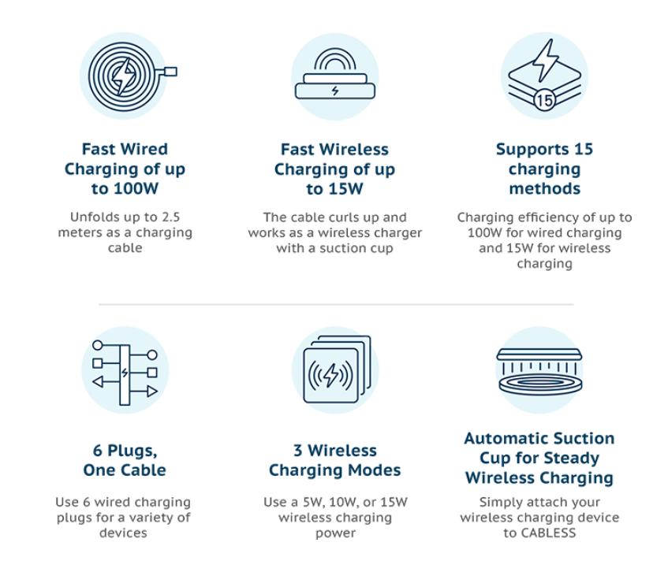
Flow Chart

Slide 15
Effective utilization of the Modern Tool & Cloud
The testing of the metaboards can be done using Google cloud IoT Core of the Google IoT platform, as its key functionality lies in providing energy and would be useful for testing the devices for charging.
Securely connect existing device network
Make informed decisions at global scale
Establish two-way communication with devices
end-to-end security

Slide 16
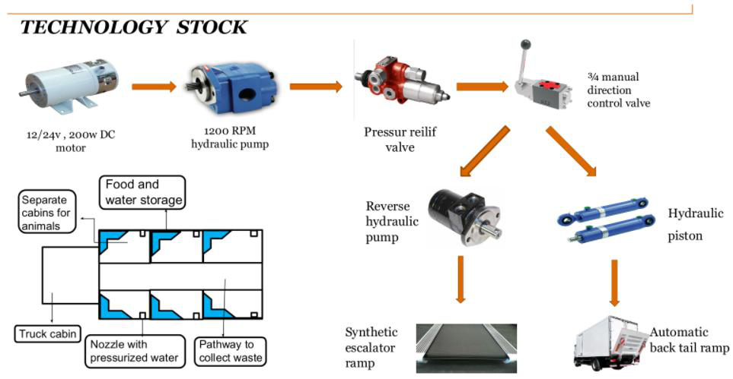
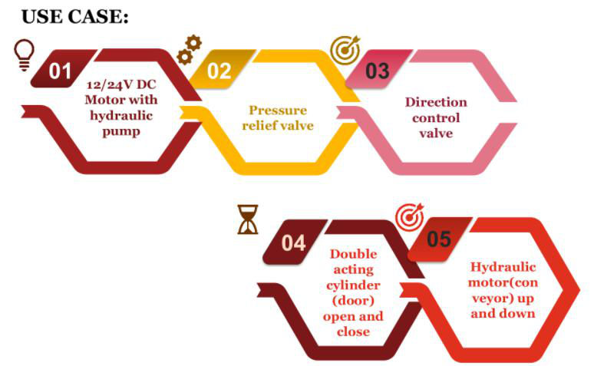
Technology stack & use case

Slide 17
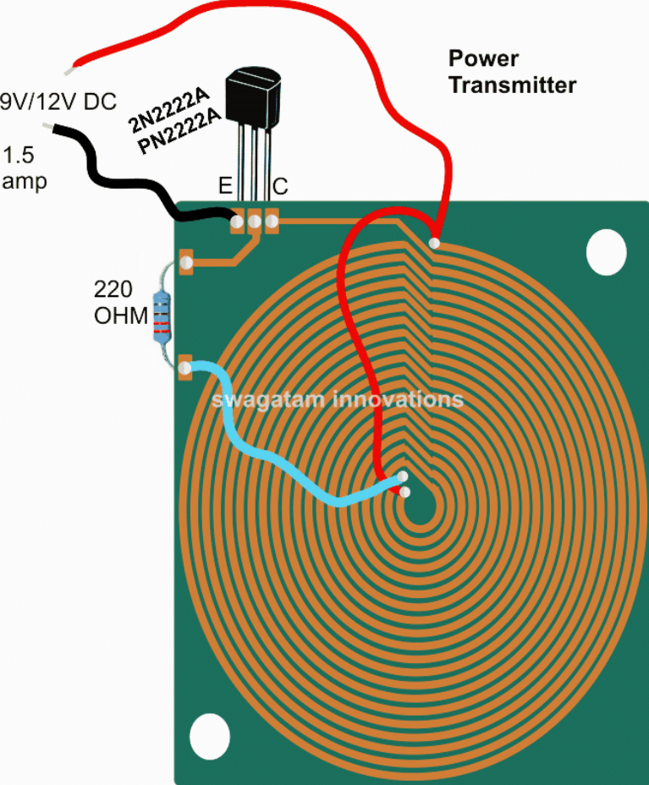
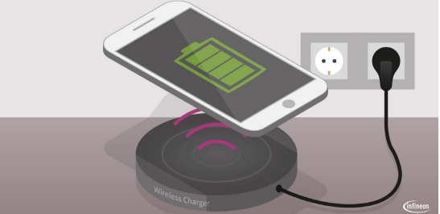
Prototype & Sample Output

Slide 18
Analysis of Results & Discussions
Compatibility issues, Safety issues, Smart heat management , Increasing efficiency and reducing charging times, Preventing device and battery damage , Easy charging without plugging in your device Greater user experience with wireless charging , No tangled wires and damaged cables , Sealed devices: water and dust resistant ,Charging multiple devices in parallel , Interoperability between chargers, no need to bring your own cable , Appealing design: no need to have external openings

Slide 19
Cost Benefit Analysis (List of Components / Service Used)
S.No | Component Name | Specification (IC number or Range or Value) | Unit Cost | Total Cost
1 | Transmitter (metamaterial) | Graphene | 300 | 952
2 | Resistor | 1002 | 60 | 300
3 | Battery | Lithium ion battey 3.7V | 265 | 795

Slide 20
Working video Link (If available)
See our video at https://vimeo.com/662995614

Slide 21
References
[1] A. Costanzo, M. Dionigi, D. Masotti, M. Mongiardo, G. Monti, L. Tarricone, and R. Sorrentino, “Electromagnetic Energy Harvesting and Wireless Power Transmission: A Unified Approach,” Proceedings of the IEEE, vol. 102, no. 11, pp. 1692-1711, Nov. 2014.
[2] J. Garnica, R. A. Chinga and J. Lin, “Wireless Power Transmission: From Far Field to Near Field,” Proceedings of the IEEE, vol. 101, no. 6, pp. 1321-1331, June 2013.
[3] J. O. McSpadden, and J. O. Mankins, “Space Solar Power Programs and Microwave Wireless Power Transmission Technology,” IEEE Microwave Magazine, vol. 3, no. 4, pp. 46-57, Dec. 2002.
[4] T. A. Vanderelli, J. G. Shearer, and J. R. Shearer, “Method and Apparatus for a Wireless Power Supply,” U.S. patent number 7,027,311, issued in April 2006.
[5] J. O. McSpadden, and J. O. Mankins, “Space Solar Power Programs and Microwave Wireless Power Transmission Technology,” IEEE Microwave Magazine, vol. 3, no. 4, pp. 46-57, Dec. 2002.
[6] T. A. Vanderelli, J. G. Shearer, and J. R. Shearer, “Method and Apparatus for a Wireless Power Supply,” U.S. patent number 7,027,311, issued in April 2006.
[6] Y. G. Kim, Y. Lim, S. Yun, and S. Nam, “Mutual Coupling Analysis of Antennas in Layered Media Through Equivalent Sources for Wireless Power Transfer,” in Proc. of IEEE Radio Science Meeting (Joint with AP-S Symposium), Memphis, TN, July 2014.
[7] X. Lu, P. Wang, D. Niyato, and E. Hossain, “Dynamic Spectrum Access in Cognitive Radio Networks with RF Energy Harvesting,” IEEE Wireless Communications, vol. 21, no. 3, pp. 102-110, June 2014.
[8] X. Lu, P. Wang, D. Niyato, and Z. Han, “Resource Allocation in Wireless Networks with RF Energy Harvesting and Transfer,” to appear in IEEE Network.
[9] S. Ladan, N. Ghassemi, A. Ghiotto, and K. Wu, “Highly Efficient Compact Rectenna for Wireless Energy Harvesting Application,” IEEE Microwave Magazine, vol. 14, no. 1, pp. 117-122, Jan. 2013.
[10] J. Gao, “Traveling Magnetic Field for Homogeneous Wireless Power Transmission,” IEEE Transactions on Power Delivery, vol. 22, no. 1, pp. 507-514, Jan. 2007

